Slide 1

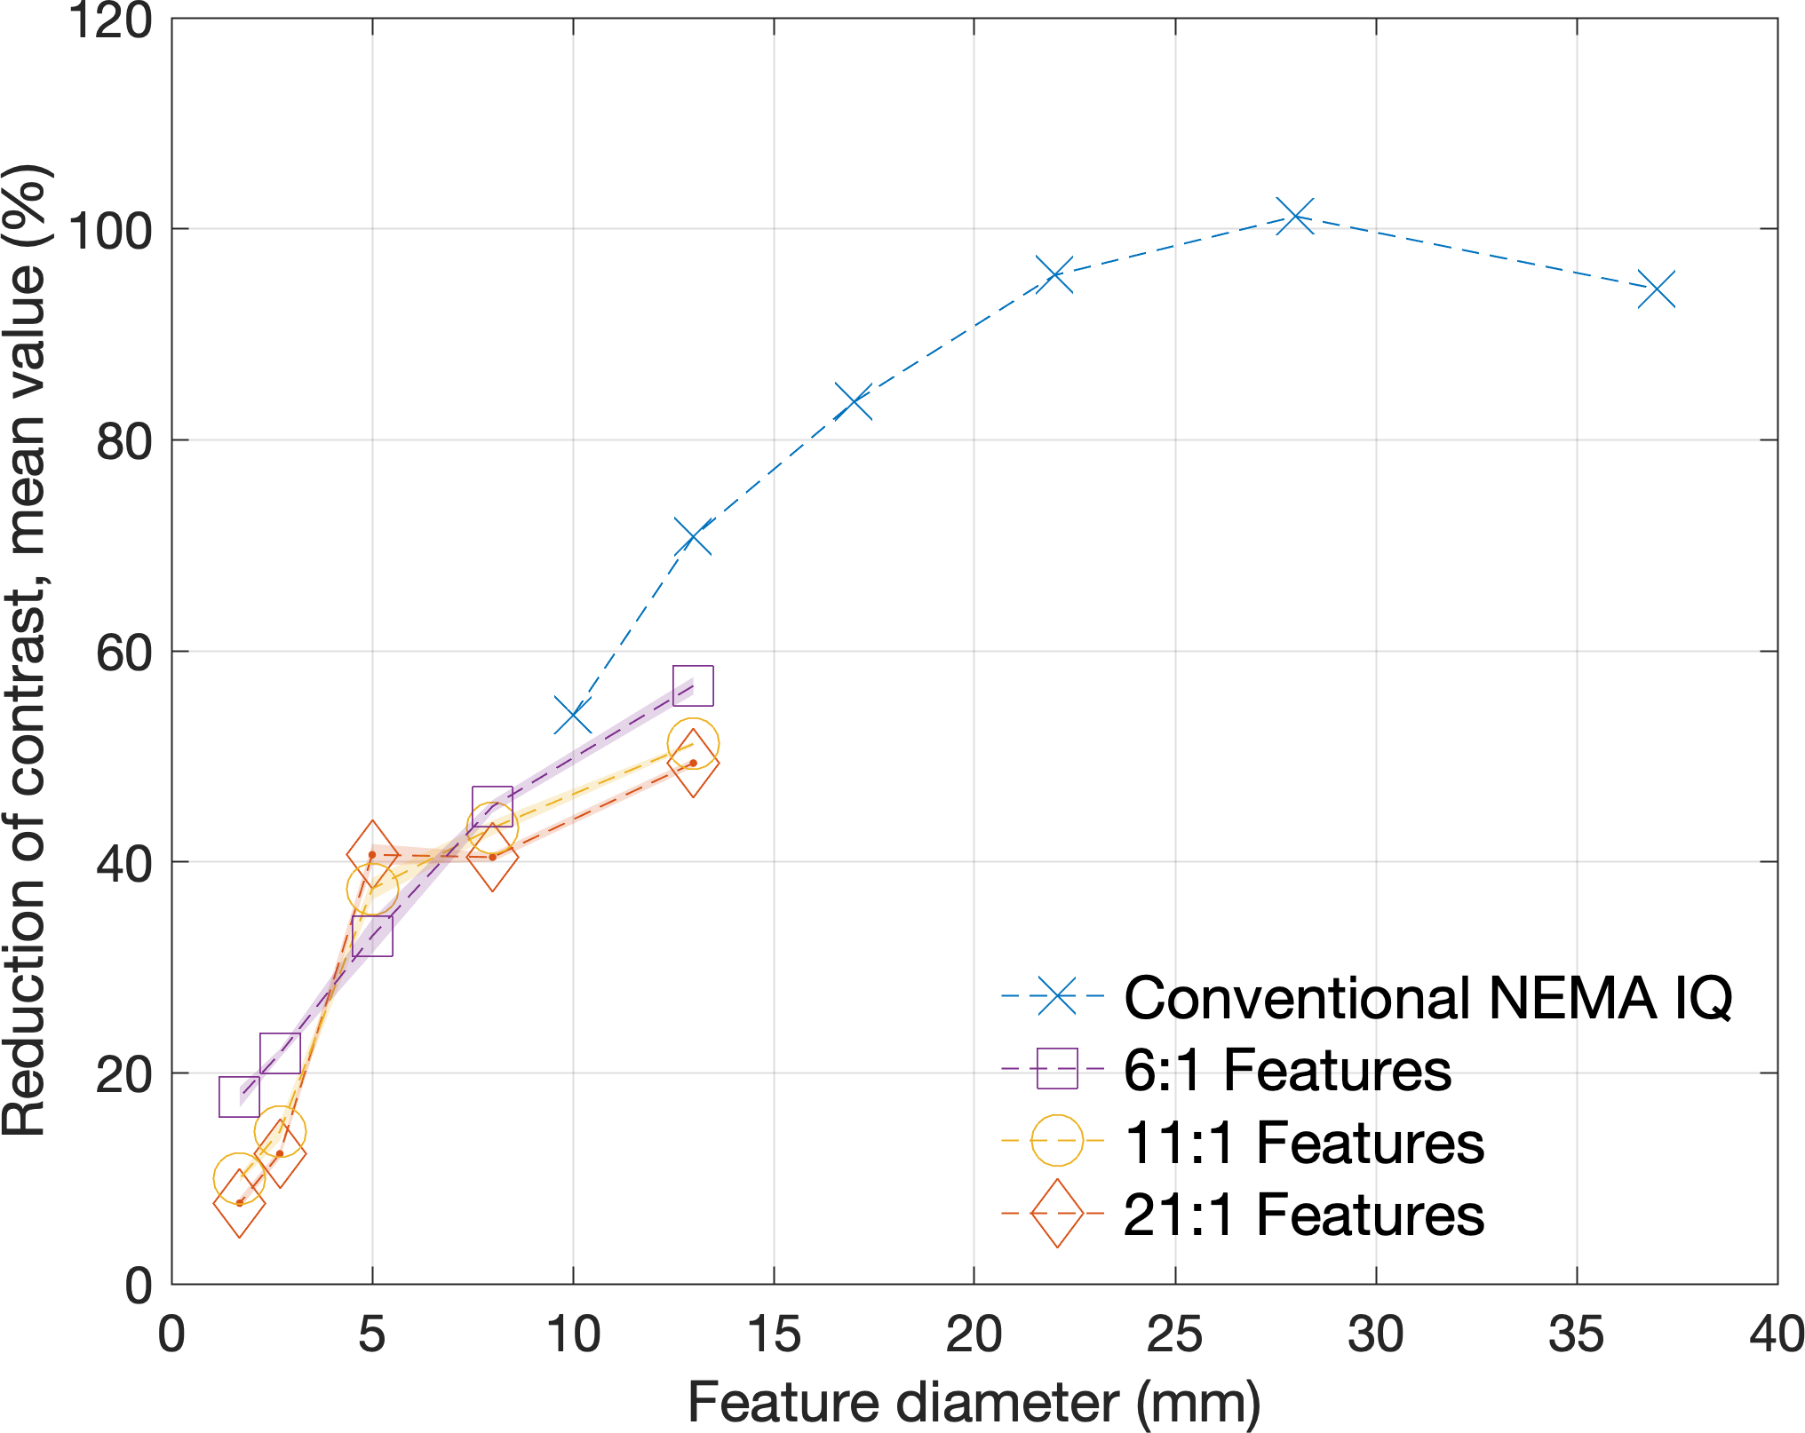
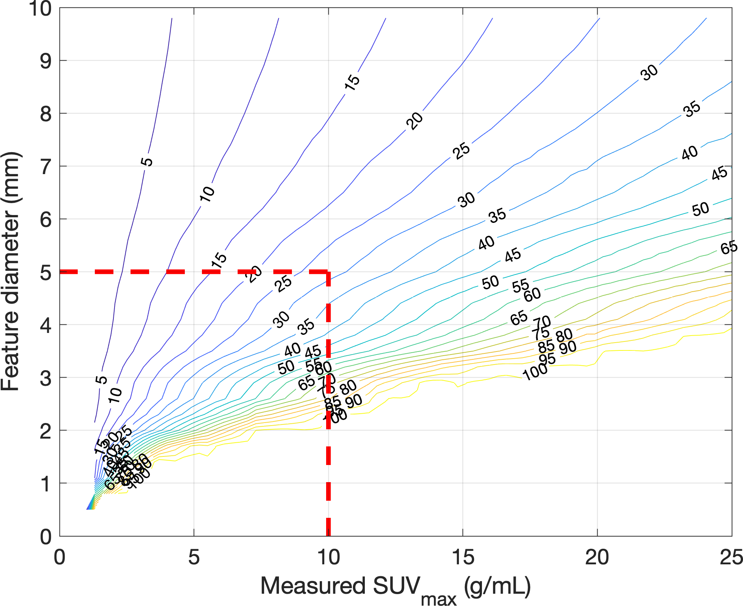
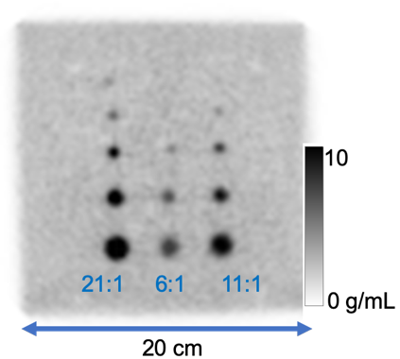
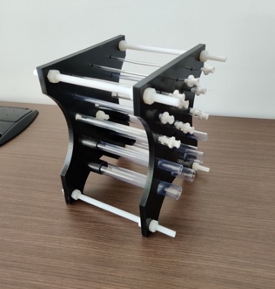
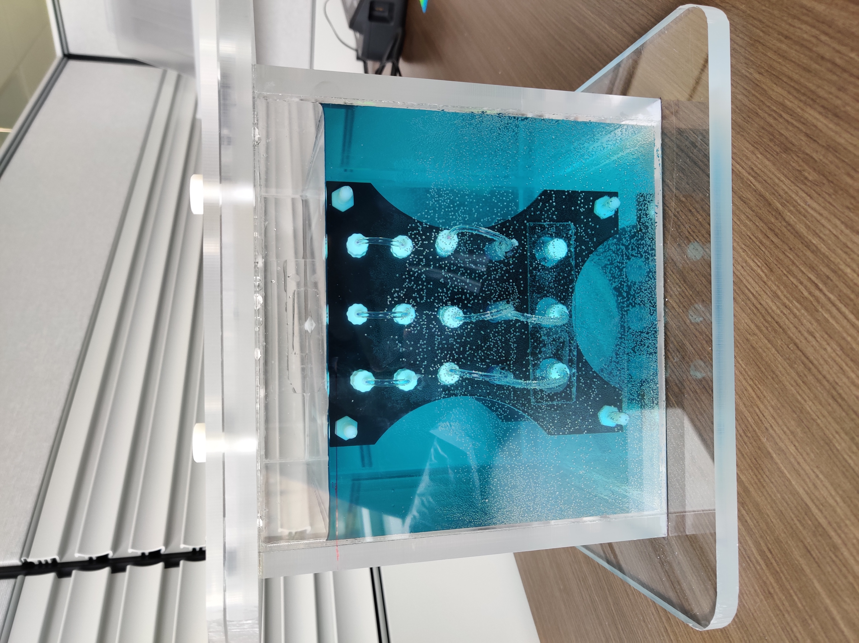
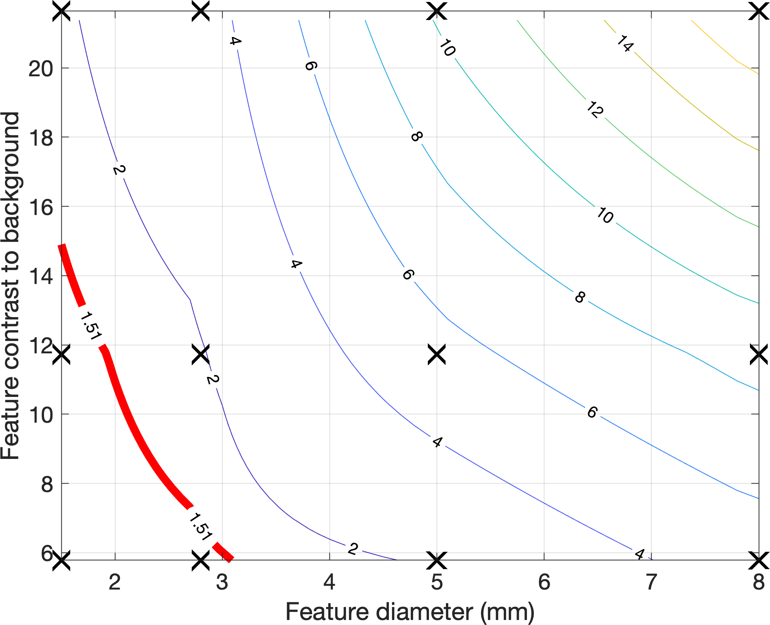
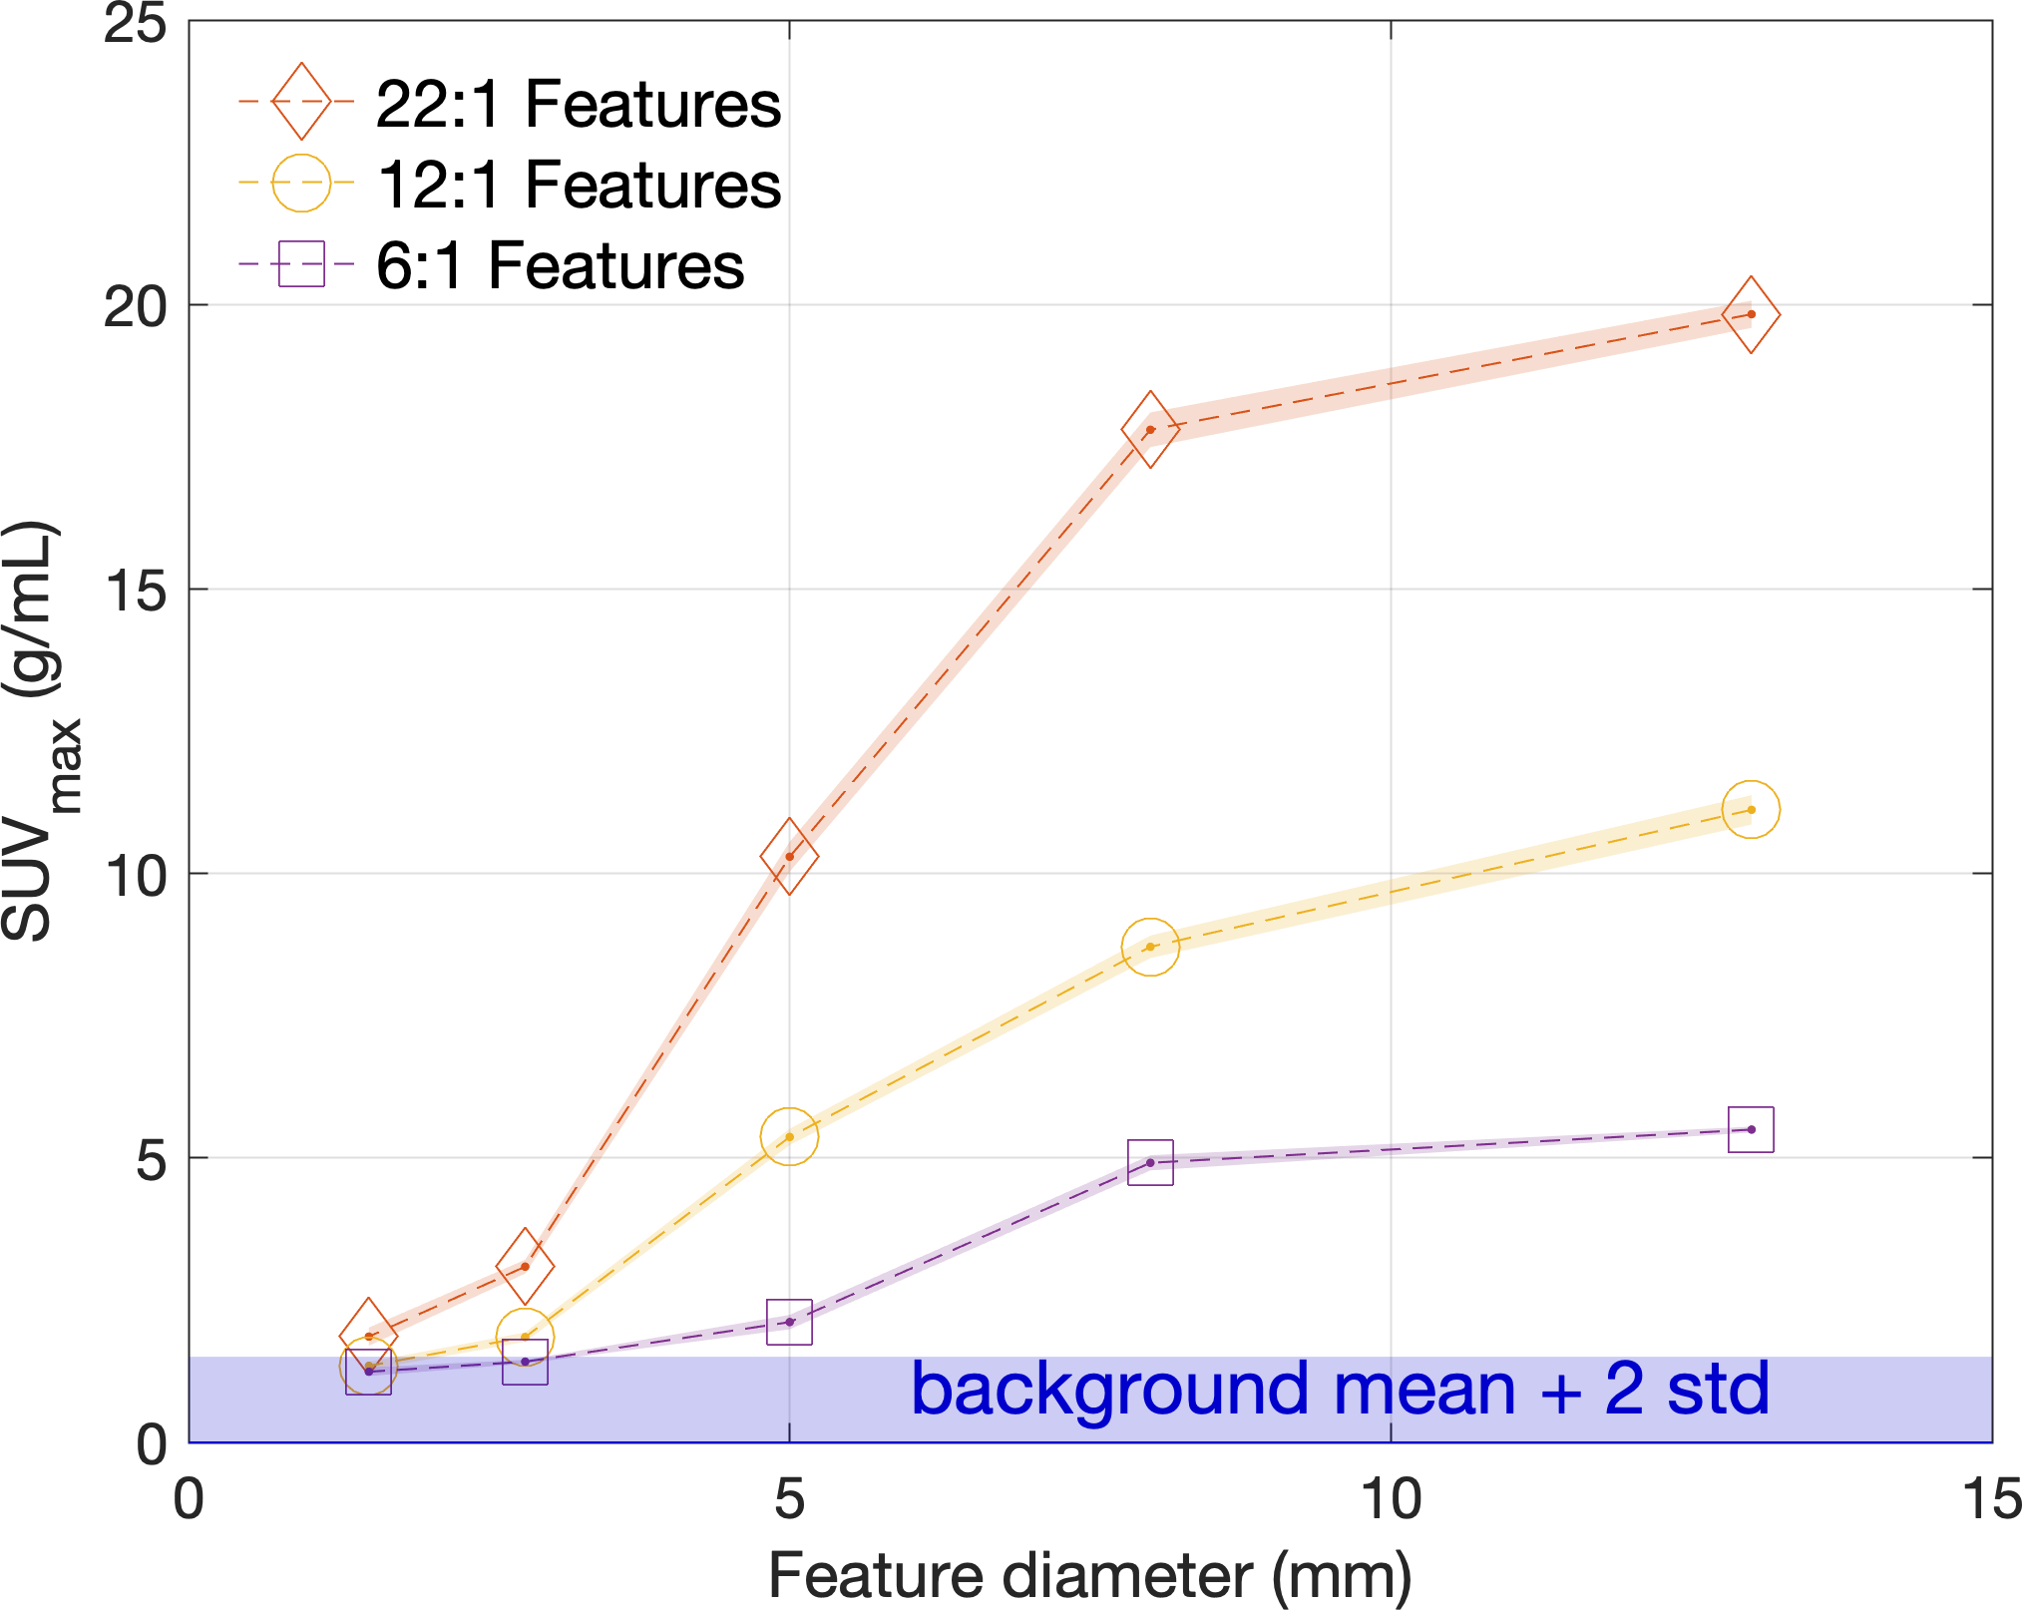

Characterization of Partial Volume Errors in Coronary Plaque PET Imaging
Results
Adam Alessio¹, Joe Adams¹, Martin Lyngby Lassen², Piotr Slomka²
¹Michigan State University; ²Cedars-Sinai Medical Center
aalessio@msu.edu
Abstract
Proposed Range
Conventional PVE Measurements
Developed a physical phantom and analysis to characterize the quantitation and detection performance of PET scanners for 1-10mm features for performance evaluation of 18F-NaF coronary plaque imaging
Objectives: Partial volume errors (PVE) in PET imaging occur because of the limited spatial resolution of the system and the regularization of noise in images. Typically, these errors are characterized with phantoms such as the NEMA IQ phantom for features ranging from 10 to 40 mm in diameter. PET is increasingly used to image smaller features, such as coronary plaques where 18F-NaF is a strong marker for microcalcification. The coronary plaques are often in the size range of 1-4 mm across and 2-10 mm long, smaller than the current NEMA IQ phantom range. This work developed a physical phantom to characterize the PET imaging performance of small plaque features in order to determine limits of detectability and PVE correction methods.
Methods: A custom phantom was designed consisting of a background chamber and a cylindrical support structure that supports 15 cylindrical features. The features have 5 different diameters [13, 8, 5, 2.7, and 1.7 mm] and can be filled with different activity concentrations. As an initial test, the phantom was filled with a 20 to 1; 10 to 1; and 5 to 1 activity concentrations in the feature compared to background and scanned on a GE DSTE PET/CT system (Waukesha, WI). A clinical high-resolution acquisition was employed (15 min/bed; OSEM 4 iterations, 28 subsets, 3mm post-filter, 2 mm^2 pixels).
Results: Analysis of the apparent values in the 15 features yielded contrast recovery curves demonstrating reduced contrast for smaller features. A threshold of detectability was defined as having a value greater than the mean plus two standard deviations of the background values, reflective of a >95% likelihood of seeing a feature assuming normally distributed noise. This threshold confirmed the visual assessment of the images showing that features with contrast of 5:1 and a size less than 2.7 mm across were not detectable. The maximum values of the 15 features sampled the 2D space of different contrast and sizes; This 2D surface was interpolated to create isocontour lines of shared maximum SUV values, permitting estimation of the detectability of different types of features for a tested scanner, protocol, and count density. Furthermore, this single scan provides the contrast recovery curves that could be used for partial volume correction of features with known size.
Conclusion: We present a new phantom design to characterize the partial volume errors of small features in PET imaging. This phantom and subsequent analysis provides an estimate of the necessary contrast and size to permit detection of these features and the associated contrast recovery curves.
Fig 4. Percent reduction of SUV Mean as function of feature diameter. Compares results from conventional NEMA IQ to proposed phantom
Motivation
Imaging of Phantom
Quantitation: If have an SUVmax measurement on a known plaque size, can estimate partial volume corrected SUVmax with following:
PET imaging is increasingly being used to image small features (<10mm), such as coronary plaques where 18F-NaF is a marker for microcalcification
Current system characterization uses phantoms with relatively large hot features (10-40 mm diameter)
Representative PET Image (single slice)
3D MIP of PET Volume
1.7mm
Fig 5. Isocontours of real SUVmax values as a function of feature diameter and apparent SUVmax. For example, if you measure 10 g/mL on a 5mm feature, the real SUVmax is 29 g/mL
Phantom
13mm
Fig 2. Representative images of phantom containing 3 contrast levels and 5 sizes. Acquired on DSTE PET/CT (GE Healthcare) with clinically relevant background count level for 15 minutes, mirroring proposed NaF coronary plaque protocols.
Detection: What are the limits of detecting small features?
Fig 3. Analysis of single image volume from plaque phantom presenting the SUVmax values for the 15 features. The value of the background plus two standard deviations demonstrates that certain small, low contrast features are indistinguishable from the background; In this case, the 2.7 and 1.7 mm features with 6:1 contrast to background and the 1.7 mm with 11:1 are not detectable, as confirmed in Figure 2.
Fig 6.Isocontour plot of the SUV max values for different contrast to background levels (y-axis) and different feature sizes (x-axis).
Right of red line is detectable (p<0.05)
For example, a 2 mm feature would require a contrast to background of 12:1 to be visible with this scanning protocol.
detectable
Fig 1. Photos of cylindrical phantom with 15 features with diameters [13, 8, 5, 2.7, 1.7] mm, to represent potential size of uptake in coronary plaques. This phantom is positioned in a warm background chamber. Phantom contains features with 3 different contrast levels at 5 sizes. Phantom designed to allow single injection fill for each contrast level (easy to prep).
detectable
MIDI Lab
www.midilab.org
Notes:
1
1

